Slide 1
ELTEK BBS CONFIGURATIONS

Slide 2
INTRODUCTION
This document is meant to guide you when executing tasks on the Eltek BBS.
All executed using Powersuite SW (Latest version 3.6)
IP: 192:168:10:20
Passwords
-3 –for viewing
-709 ---Factory access
Main tasks include;
-Loading set-ups
-Setting Battery parameters
-Calibrating currents
-Setting communication parameters
-Activating Hybrid

Slide 3
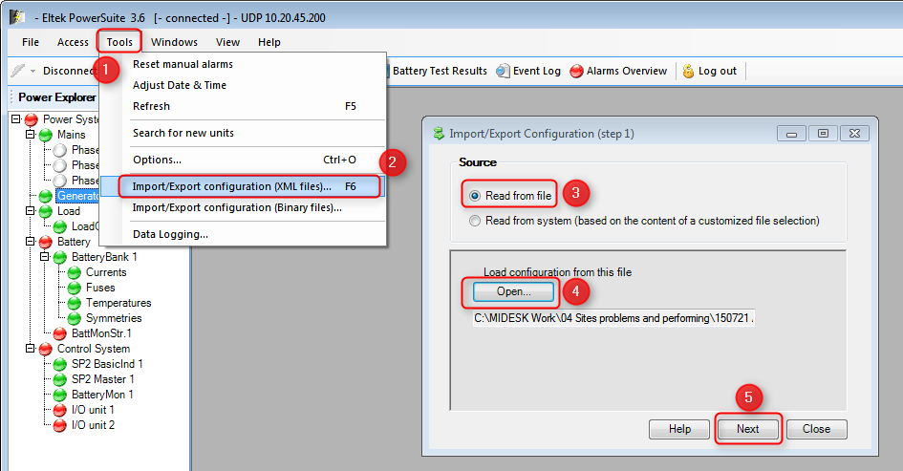
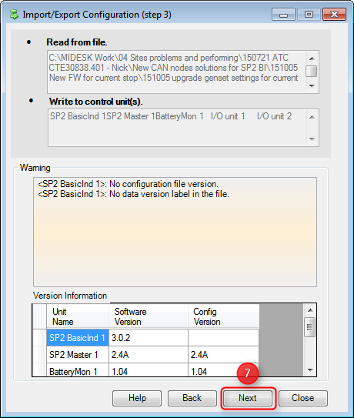
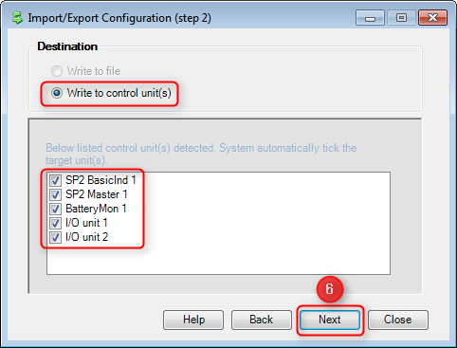
Loading Set-up
Below are the steps;

Slide 4
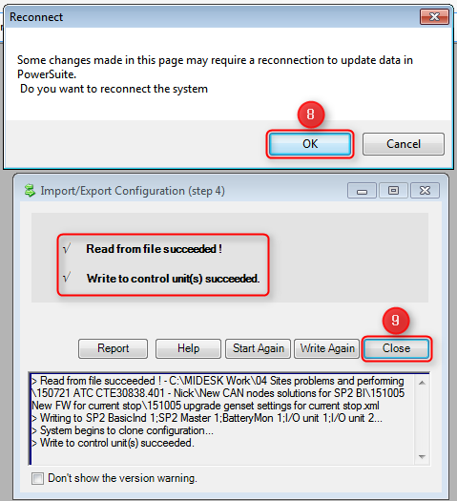
.

Slide 5
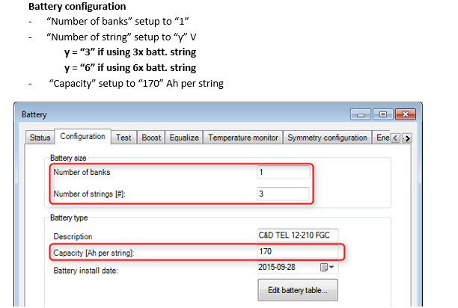
Setting battery Parameters

Slide 6
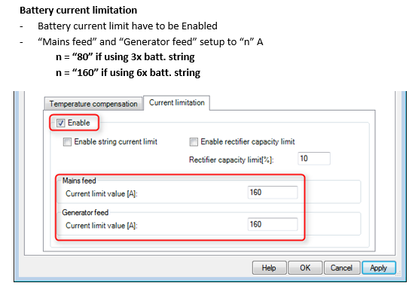
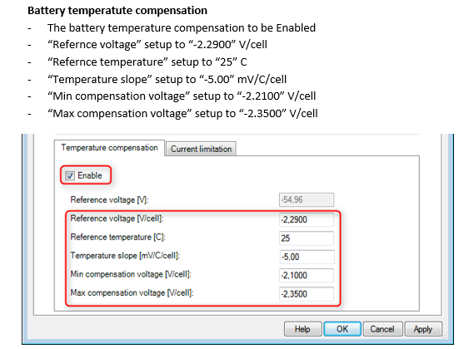
.

Slide 7
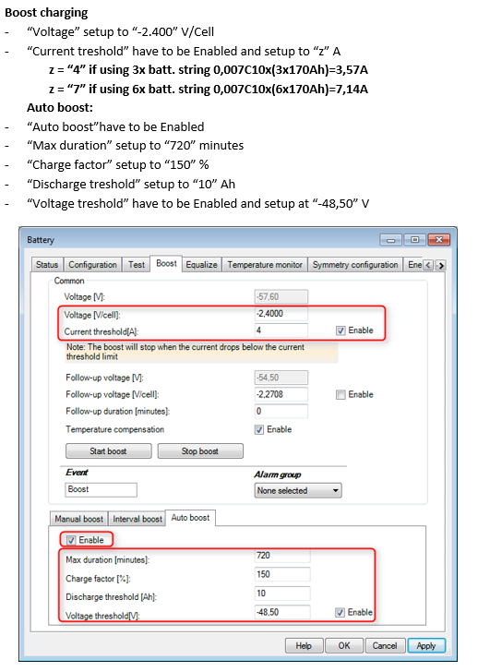
.

Slide 8
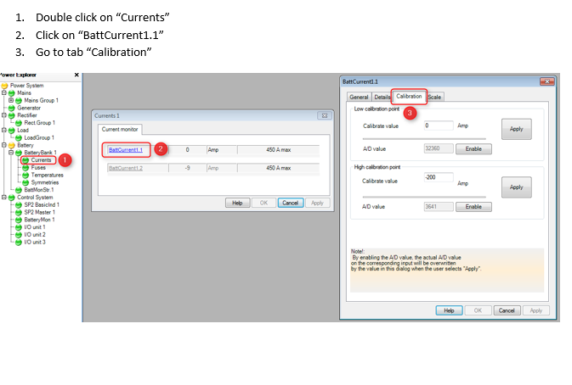
Calibrating currents

Slide 9
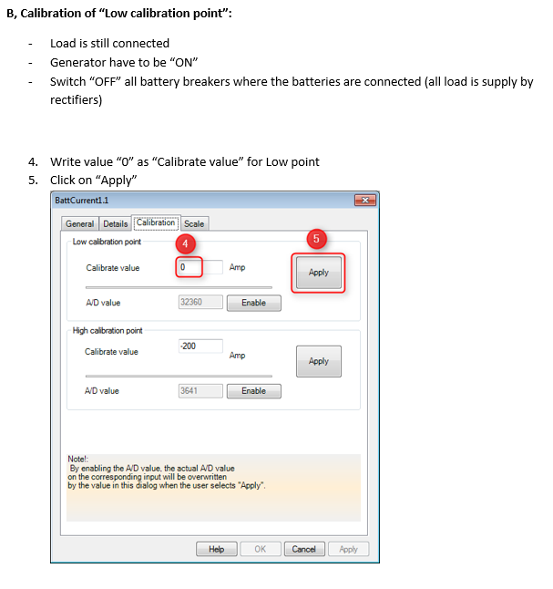
.

Slide 10
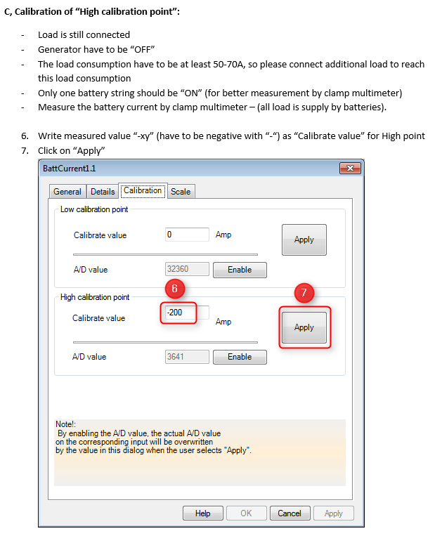
.

Slide 11
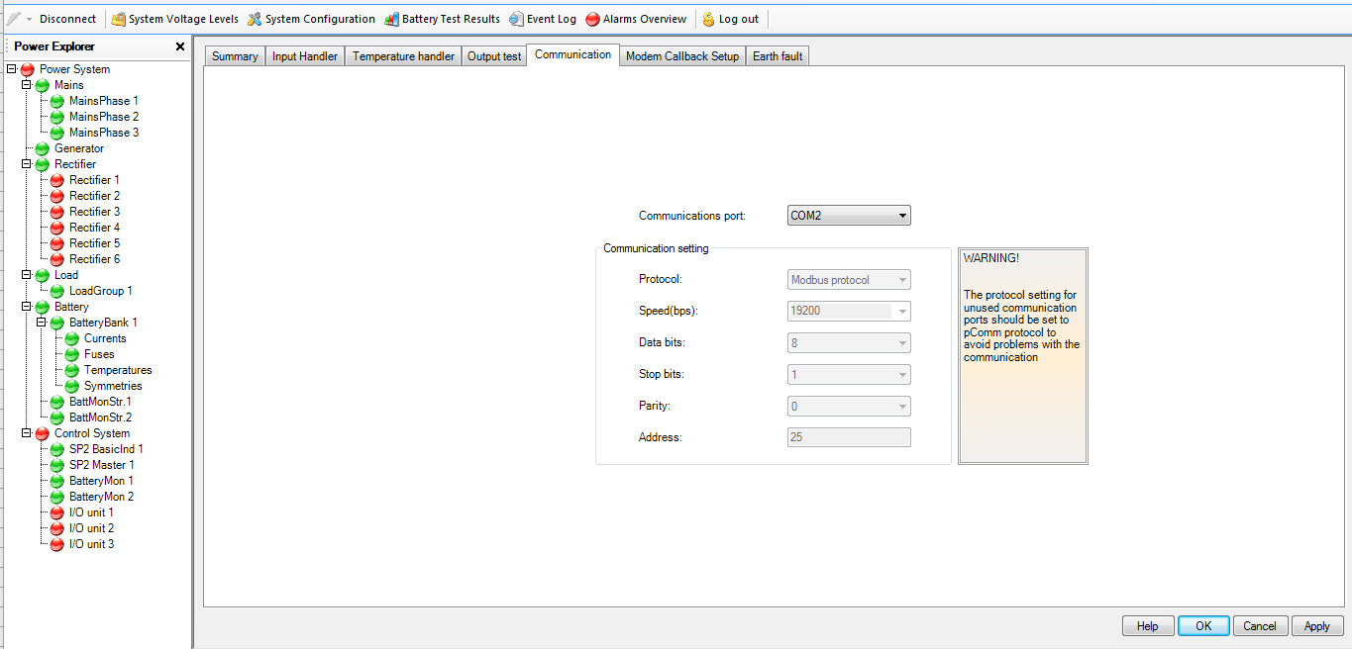
Setting galooli communication parameters

Slide 12
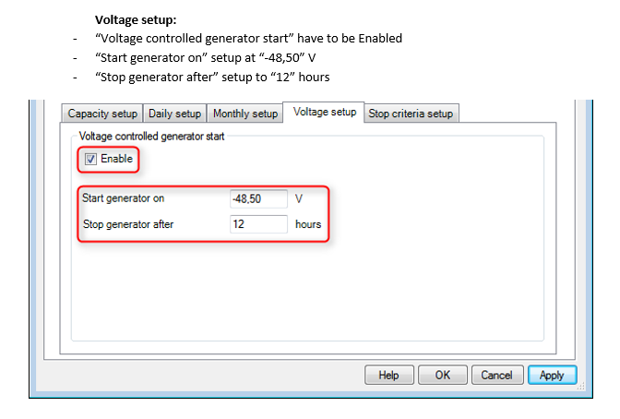
Hybrid activation
We use voltage set-up as the start criteria ,the current as the stop criteria
All are under generator configurations;

Slide 13
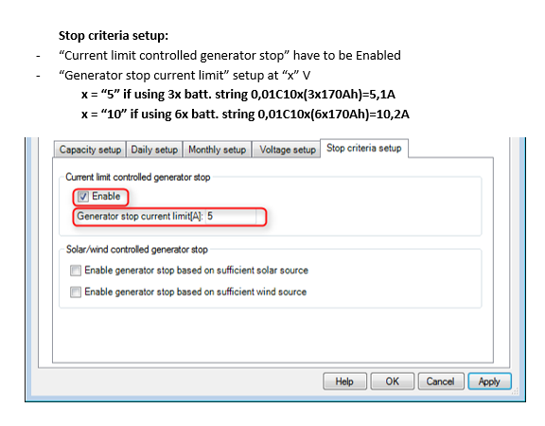
Stop criteria

Slide 14
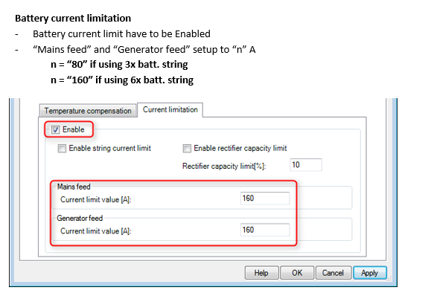
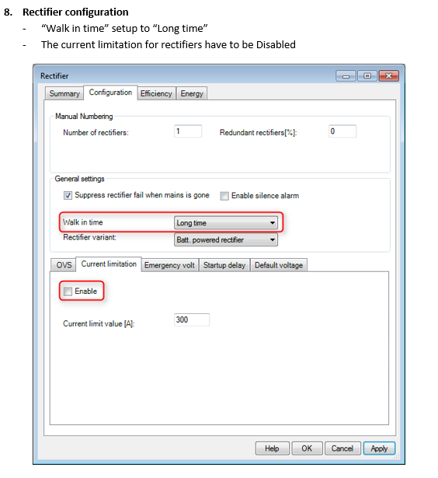
Other settings

Slide 15

.

Slide 16
Thank you
.

